Slide 1
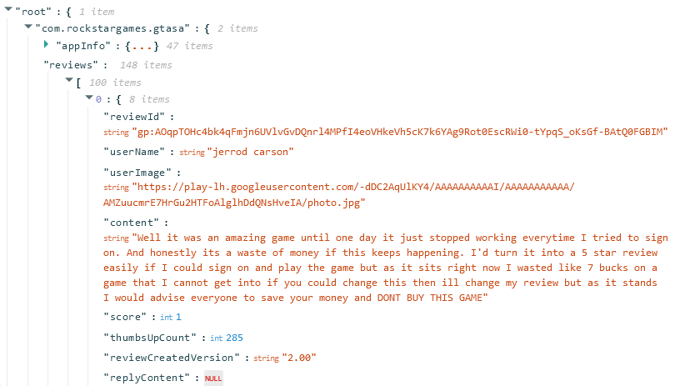
NOSQL Database Portfolio Project
An Overview into the process

Slide 2
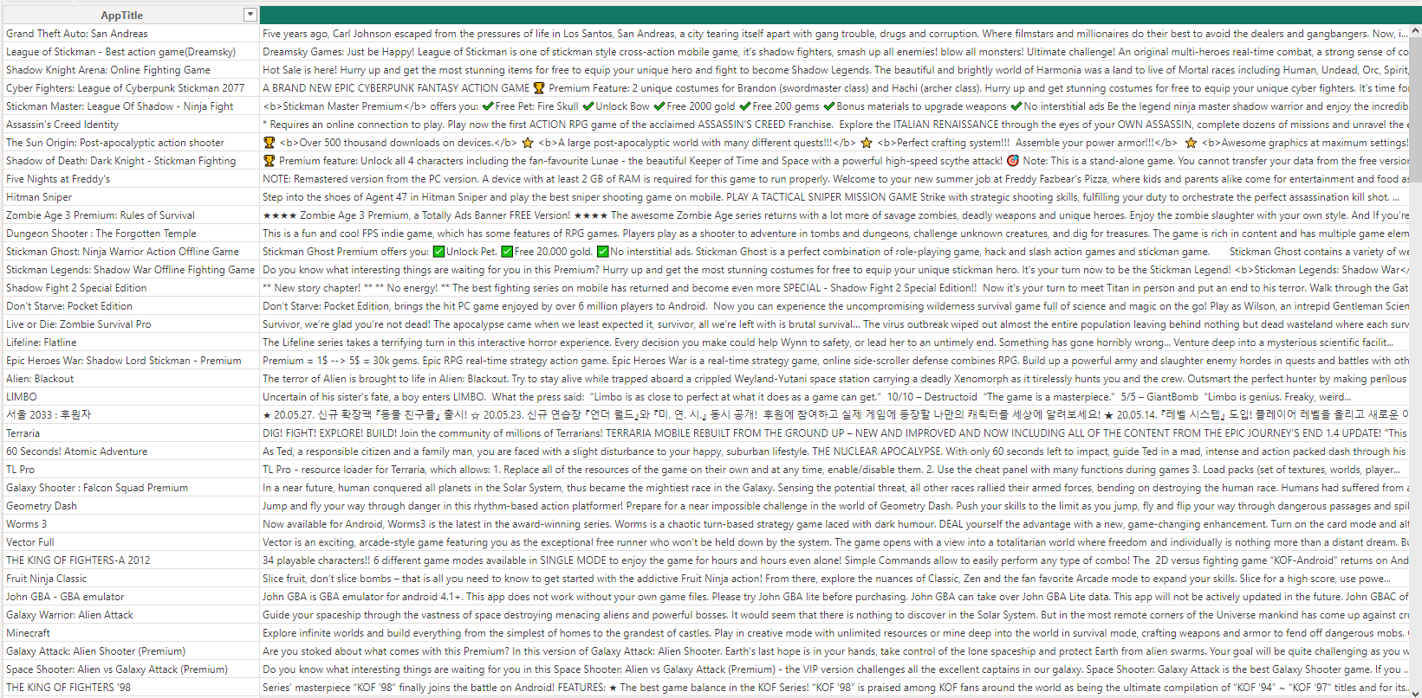

Project Summary
NOSQL (Not Only SQL) is a branch of the SQL relational database language that allows it to interact with unstructured data files. This project focuses on importing a non-relational database to PowerBI in order to extract insights much like any other relational database.

Slide 3
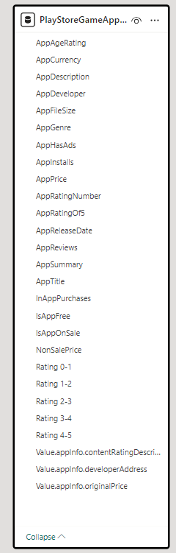
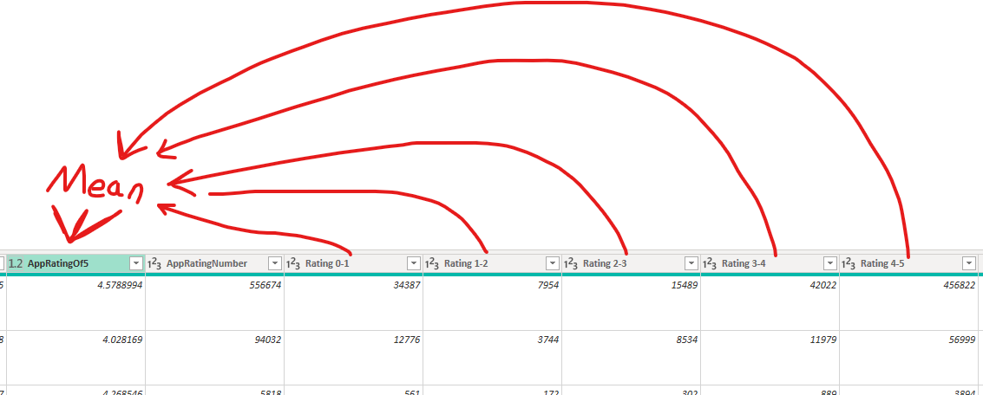
ETL (Extract, Transform, Load)
https://www.kaggle.com/datasets/dipanjandas96/play-store-game-reviews
The Database I used for the PowerBI segment can be found in Kaggle through the URL above, and covers the sales and ratings of apps on the Google Play Store in a JSON format. Starting out, cleaning this data of unnecessary fields in the ETL process was important, as there were quite a few fields that, while useful on an informational basis (like the game description), were not useful for my analysis in the same way that others (like the genre) were. Some fields were especially cryptic in their meaning due to an obscure name, though with a systematic approach they were revealed to be the amount of each rating from 1-5.

Slide 4
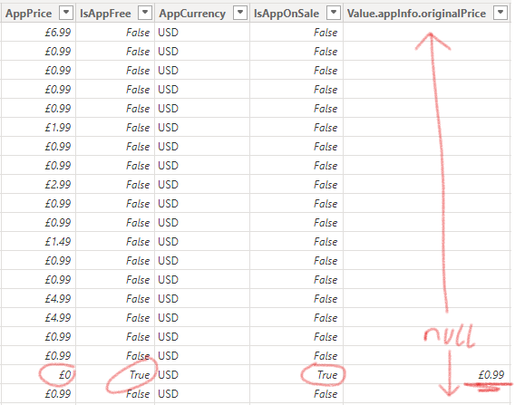
ETL (Extract, Transform, Load)
Another challenge I had was making columns that circumvented issues caused by the way the JSON had everything arranged. For instance, games on a sale were listed as free, with another column showing its real price. In order to run an accurate analysis, I had to get the actual price of everything into a single column.

Slide 5
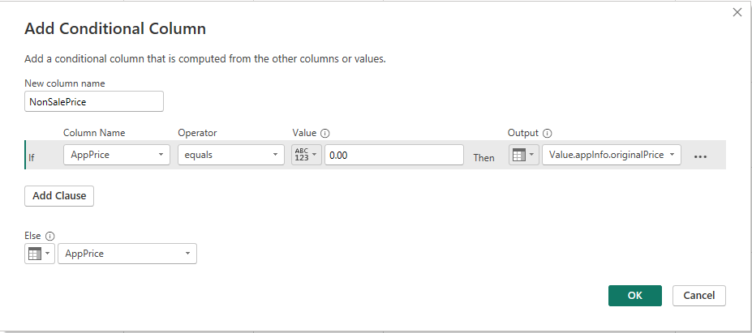
ETL (Extract, Transform, Load)
I wanted to combine the standard price and non-sale price fields into one so I could analyse all of them based on their actual price. I managed to do so by creating this calculated column, then making another that multiplies this field by how many installs were made to grant the upper bound of revenue made (since these games can spend time on sale, we cannot assume this is the true amount, but rather an upper estimate).

Slide 6
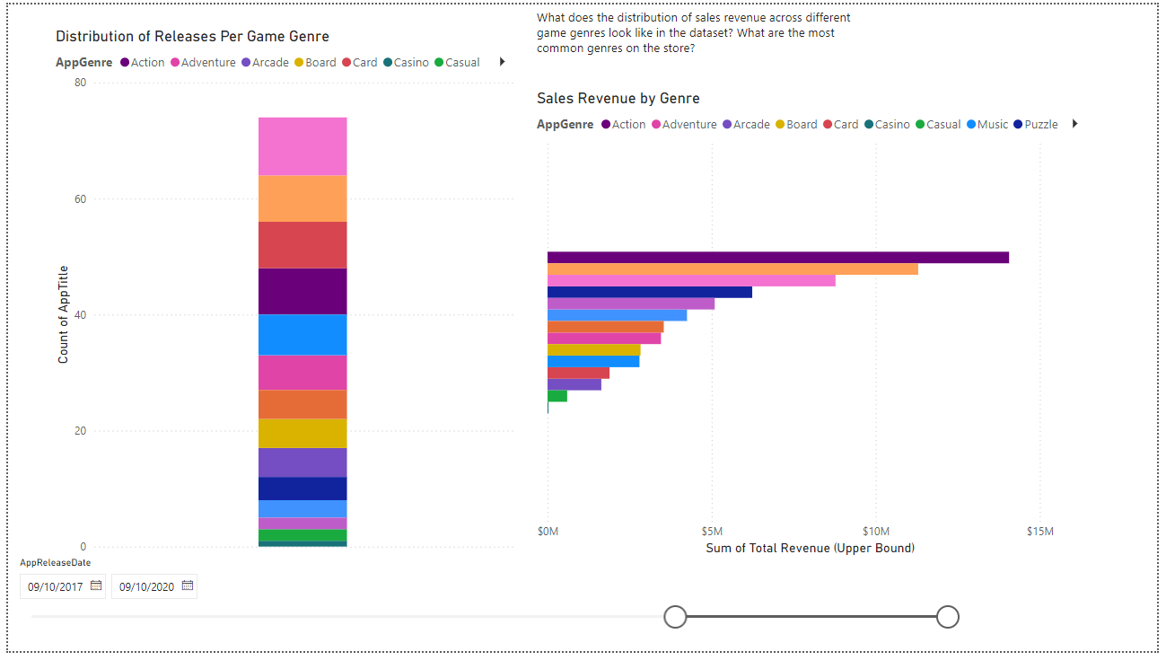
JSON Analysis
I took the time to perform some analyses with the data, which works just as well as in a relational database. For instance, this graph looks at how often games of a certain genre were released in a 3- year timespan from the release of the dataset. Interestingly, casino genre games make the smallest amount of money, perhaps offset by their major source of income stemming from the games themselves.

Slide 7
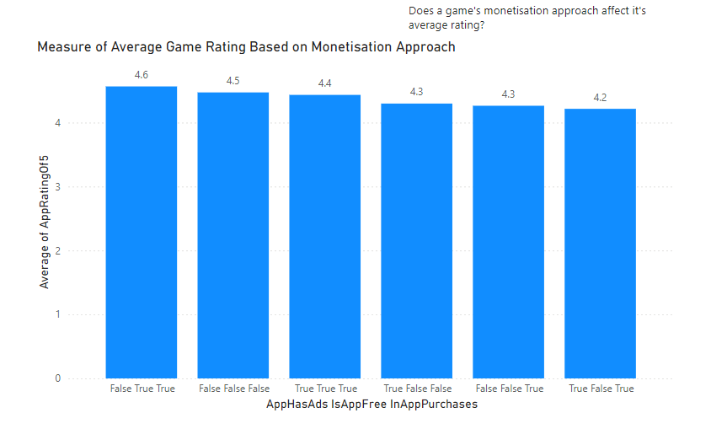
JSON Analysis
Another insight I made with this bar chart was concerning the average rating out of five for games based on their approach to monetisation, which appears to have a palpable effect. While in-game ads and microtransactions do have a direct influence on the player’s experience, correlation does not mean causation, though this is very interesting information to consider when choosing a game’s monetisation model.

